Slide 1
Dynamic Programming
Olivier Rubel, Ph.D.,
Associate Professor of Marketing

Slide 2
Outline
Bellman’s principle of optimality
Dynamic estimation via Kalman filtering
Evaluating dynamic Policies

Slide 3
Bellman’s Principle of Optimality

Slide 4
Bellman’s Principle of Optimality

Slide 5
Bellman’s Principle of Optimality

Slide 6
Optimal Policy

Slide 7
Two Examples

Slide 8
Two Policies

Slide 9
Open Table

Slide 10
Modeling Open Table

Slide 11
Modeling Open Table

Slide 12
Managing Open Table

Slide 13
Applying Dynamic Programming
Estimation of a dynamic response model of market behaviors
Sales, brand equity, stock returns, purchase
Construction of the optimal policies via DP
DP= Dynamic Programming
Solving the Bellman equation to evaluate policies
Approximation of the value function

Slide 14
Case Study: Blood
How much does a pint of blood cost?
Application: Advertising for blood
Time series on blood donations, radio advertising and phone calls

Slide 15

Why Blood?

Slide 16
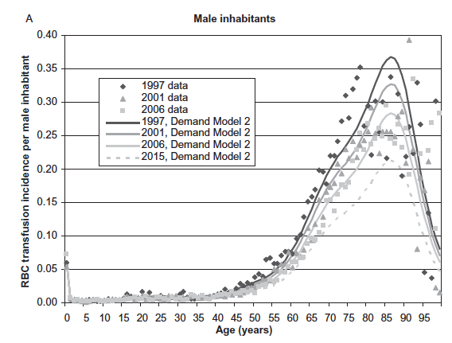
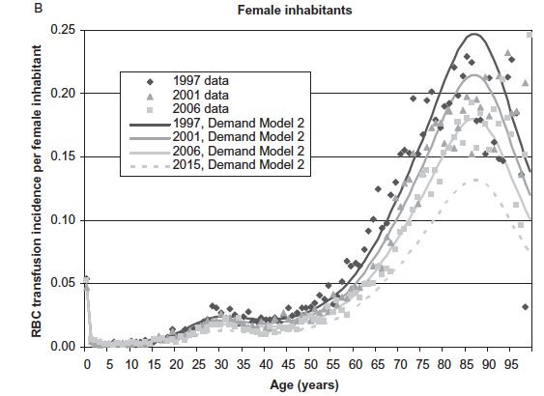
Blood “Markets”
100 Millions of pints of blood transfused every year
Blood is a $3bn business in the U.S. for instance
Blood demand grows faster than supply (6% v.s. 3%)

Slide 17
How Blood Banks Work
Patients/Doctors
Blood Demand
Blood Supply
Blood Bank
Marketing Efforts
Blood Donations
Donors

Slide 18
Marketing Blood Donations
Blood banks manage marketing resources to control the supply of blood
Managing the supply of blood, not its demand
Cannot use full marketing mix
Shortage of blood is not good
Excess of blood is not good either!

Slide 19
Applying Dynamic Programming
Estimation of a dynamic response model
Construction of the optimal policies via DP
DP= Dynamic Programming
Solving the Bellman equation to evaluate policies
We need to approximate the value function

Slide 20
Effects of Advertising on Blood Donations

Slide 21
Linear State Space Models
Linear Form
Dimensions and Names
Y: observation vector, N × 1
α: state vector, m × 1
T: transition matrix, m × m
c: drift vector, N × 1
d: drift vector, m × 1
ε: error term ~ W(0, H_{t}), H is N×N
ν: error term ~ W(0, Q_{t}), Q is m×m
z: link matrix, N x m
Observation Equation
Transition Equation
Notes:
From Prasad Naik

Slide 22
Kalman filter as Bayesian Learning
Observe Y₁
“Prior” to Y
“Posterior” to Y
Updating due to dynamics from t₀ to t₁
α_{t}
Updating due to new Y₁
Time, t
t₀
t₁
Notes:
From Prasad Naik

Slide 23
Kalman Filter as a Dynamic Optimization Problem

Slide 24
Kalman filter
Updating due to dynamics
Updating due to information
Kalman Gain Factor
Notes:
From Prasad Naik

Slide 25
Filtering + Estimation
Step One: Filtering problem
Given the model parameters, what are the optimal means and covariances of the state vector?
State Estimation
Kalman Filter (and Smoother)
Same kernel in ALL parameter estimation algorithms (MLE, EM, Bayesian)
Step Two: Estimation problem
Given the means and covariances of the state vector, what are the optimal parameter estimates?
Parameter Estimation
Maximum Likelihood
EM Algorithm
Bayesian
Notes:
From Prasad Naik

Slide 26
Maximum Likelihood Estimation
Likelihood function
Notes:
From Prasad Naik

Slide 27
ML Estimation
Optimal Parameter Estimates
Notes:
From Prasad Naik

Slide 28
ML Inference and Selection
ML Inference
Standard errors
Given by the diagonal elements of the above matrix
Compute t-values
> 1.96 ➔ significant
Model Selection
Balances fidelity and parsimony
Retain the model associated with the smallest value
> 2 point differences ➔ reject
Notes:
From Prasad Naik

Slide 29
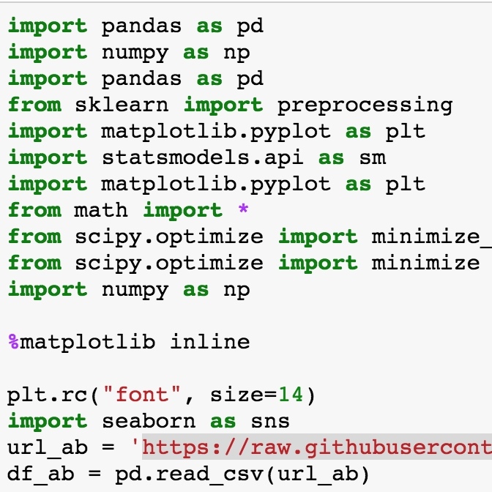
Python Implementation
Link for the data
https://raw.githubusercontent.com/ormarketing/Analytical-Decision-Making/master/ab.csv

Slide 30
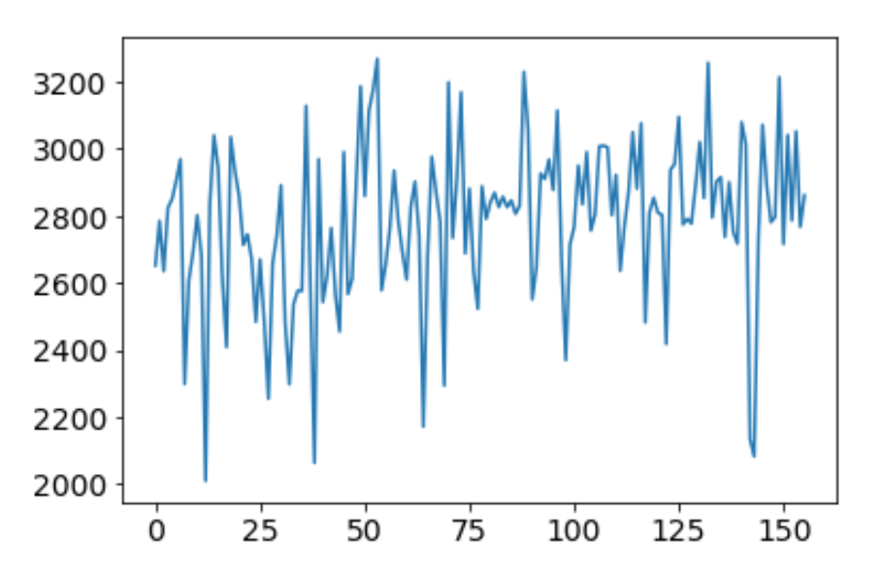
Donations over Time

Slide 31
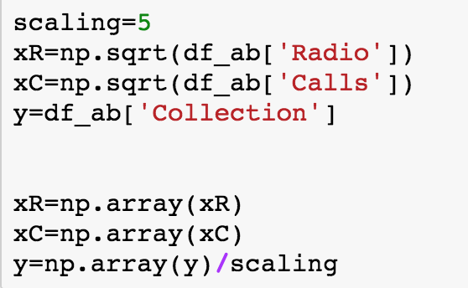
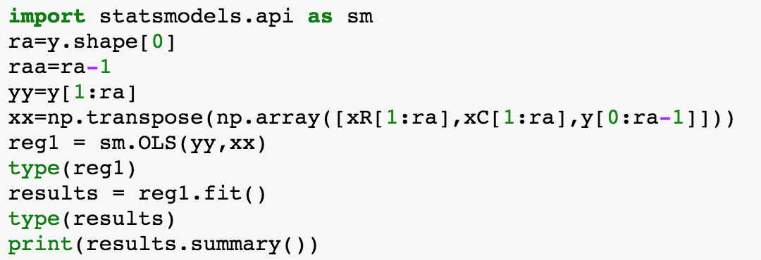
OLS Estimation

Slide 32
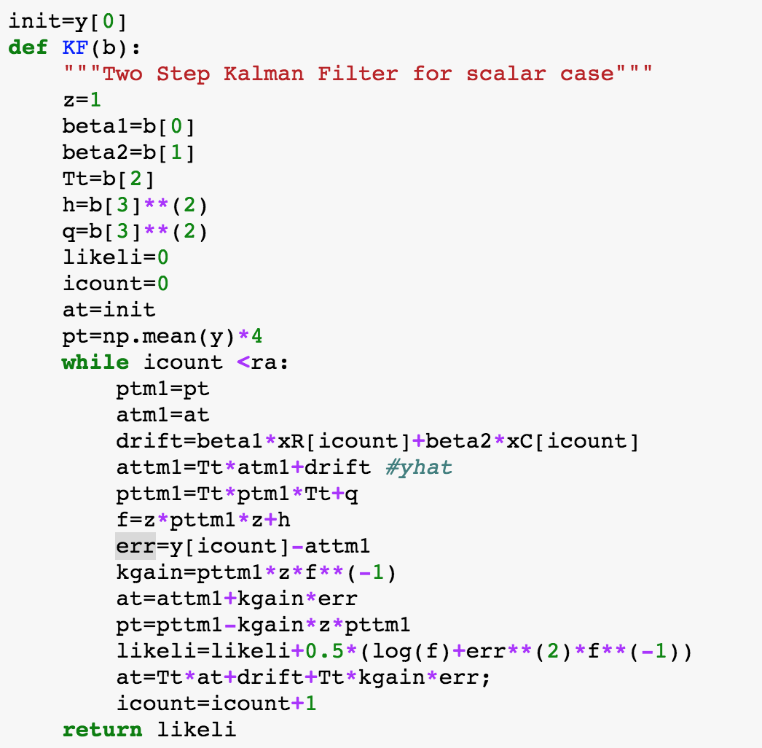
Kalman Filter Estimation

Slide 33
Kalman Filter Estimation

Slide 35
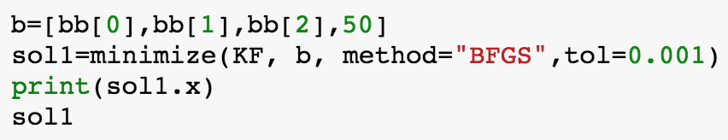
ML Estimation
Optimal Parameter Estimates

Slide 36
Results?

Slide 37
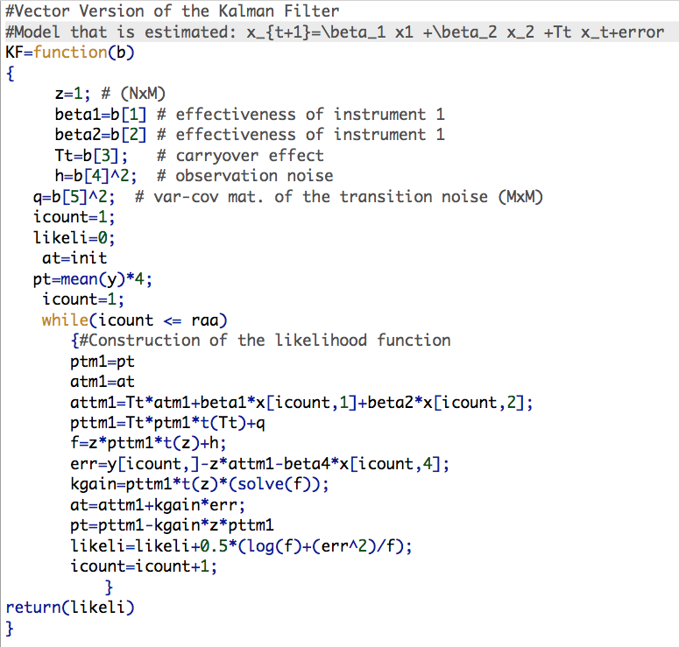
Bonus Code

Slide 38
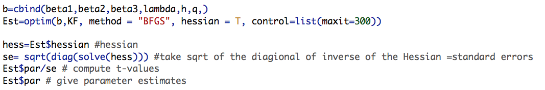
Bonus Code

Slide 39
Applying Dynamic Programming
Estimation of a dynamic response model
Construction of the optimal policies via DP
DP= Dynamic Programming
Solving the Bellman equation to evaluate policies
We need to approximate the value function

Slide 40
Managing Resources
How would you model the objective function?
Shortage of blood is not good
Excess of blood is not good either!
Need additional information on what?

Slide 41
Modeling the Objective Function

Slide 42
Bellman Equation

Slide 43
Applying Dynamic Programming
Estimation of a dynamic response model
Construction of the optimal policies via DP
DP= Dynamic Programming
Solving the Bellman equation to evaluate policies
We need to approximate the value function

Slide 44
Inserting Policies into Bellman Equation

Slide 45
Approximation of the Value Function
Notes:
Next few slides inspired by Moll.

Slide 46
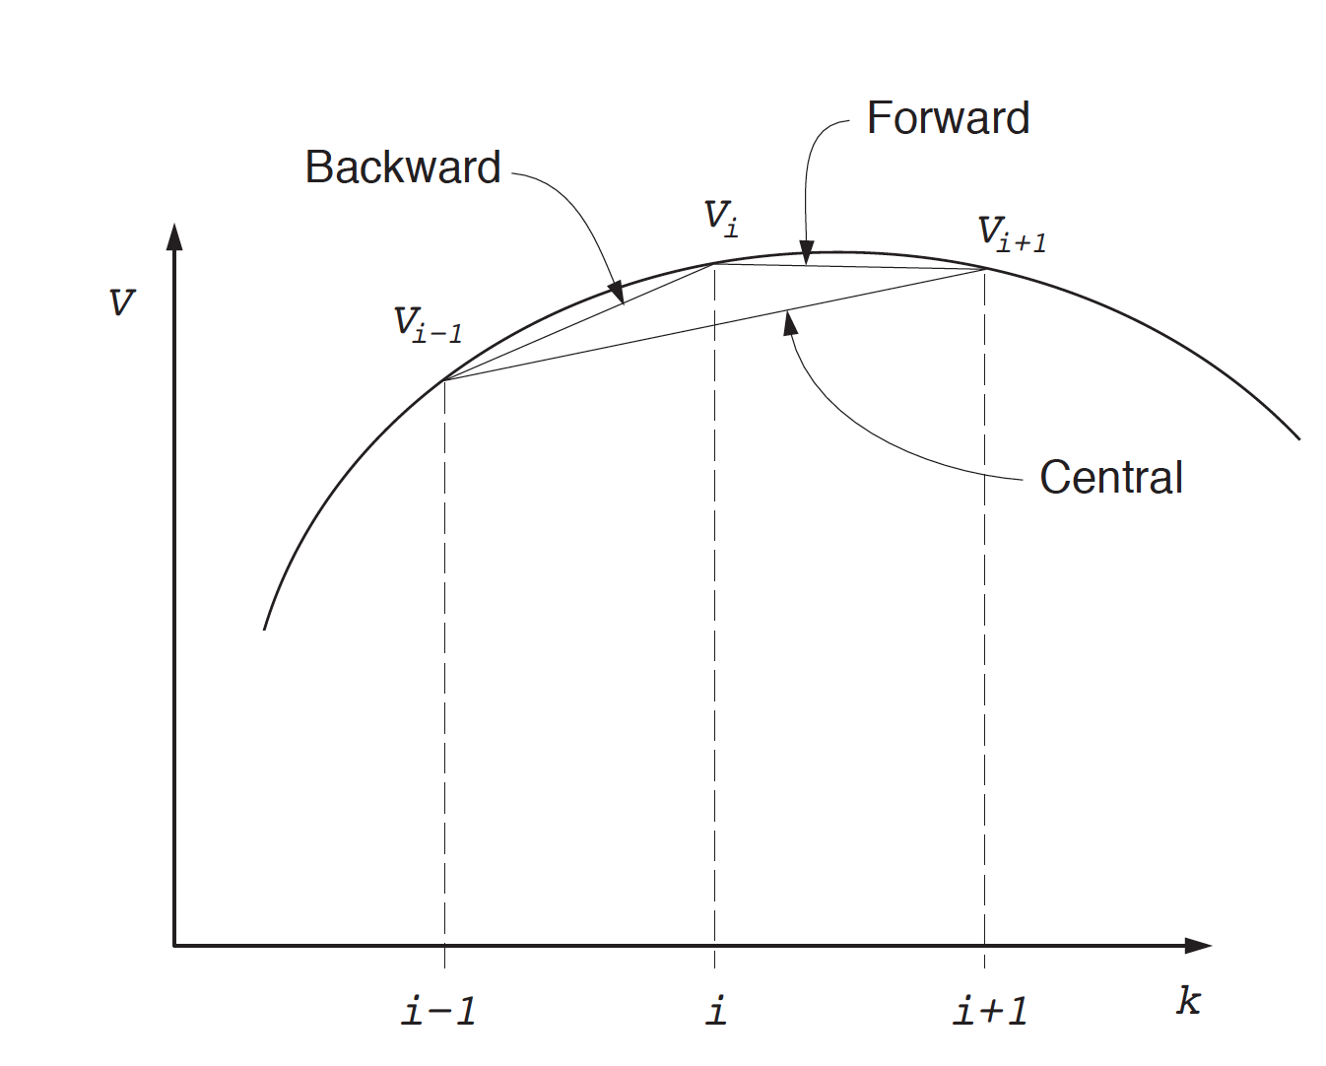
Visually

Slide 47
Approximation of the Value Function

Slide 48
One Refinement

